Slide 1

CUSTOMER CHURN IN BANKS – project 3
Deborah Paul​

Slide 2
Outline
Business Problem
Dataset
​Methods
Model development
Results/conclusion

Slide 3
Business Problem
The customer churn data for a bank is provided along with the information of customers such as the number of accounts they have, how active the customer is with their financial activity, and the demographic features of the customer. A suitable machine learning model must be developed to predict if the customer will stay with the current bank or leave based on the selected features that impact the customer churn.
The model can help banking institutions assess the factors that lead to customer satisfaction and factors that enable retention of customers.

Slide 4
Dataset
Bankchurn data.csv
The dataset has 165034 rows and 13 columns.
The column names are the following:
CustomerId, Surname, CreditScore, Geography, Gender, Age, Tenure, Balance, NumOfProducts, HasCrCard, IsActiveMember, EstimatedSalary and Exited.

Slide 5
Methods
ETL (extract, transform, and load)
Data has been extracted from the data source, and cleaned of null values, and duplicates in Python.
Identifying key variables
The important variables used for the modeling are identified through various steps such as
Incompatible datatype elimination,
Multicollinearity check, and
Identifying relevant features to the response variable through correlation.
Model development
Random forest and LightGBM classifiers will be used in Python.

Slide 6
Methods(cont’d)
Random forest algorithm
A bootstrap aggregating or bagging method in which predictions of multiple decision trees are combined through a majority voting mechanism.
Only a subset of random features and data is used to create those collections of decision trees.
- Provides flexibility - Regression and classification tasks.
LightGBM :
- It is an extended gradient boosting algorithm that uses a type of automatic feature selection and boosting examples with larger gradients.
- It converts continuous values to discrete bins which makes it use low memory space.
- It helps to achieve higher accuracy because it follows a leaf-wise split approach rather than a level-wise approach.

Slide 7
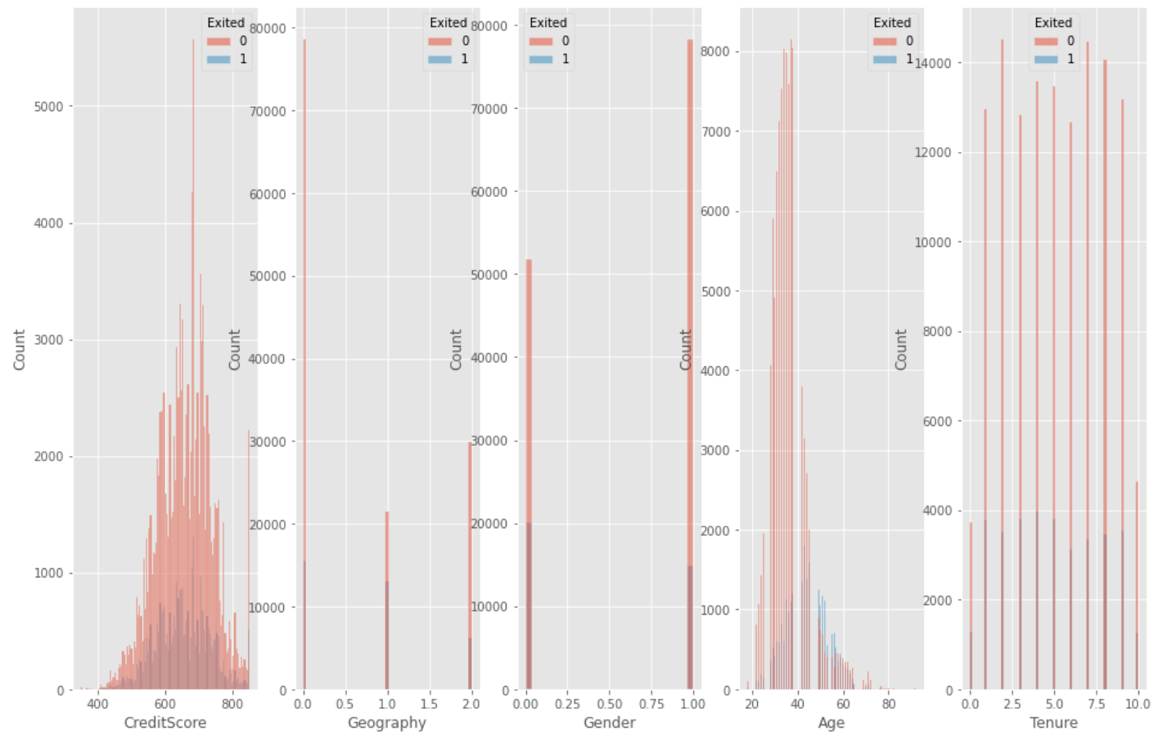
Model development
1. The distribution of data of individual X variables when plotted against the bank churn is shown below. ‘Exited’ is the response variable where 0 stands for customer staying with the bank and 1- stands for exited.

Slide 8
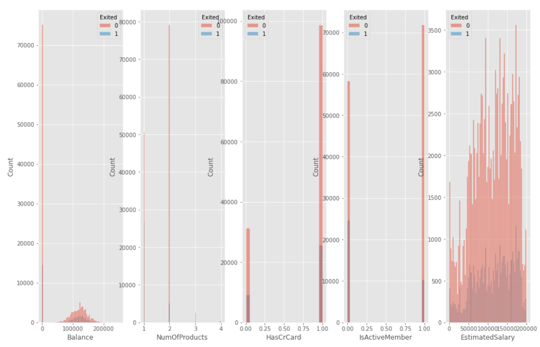

Slide 9
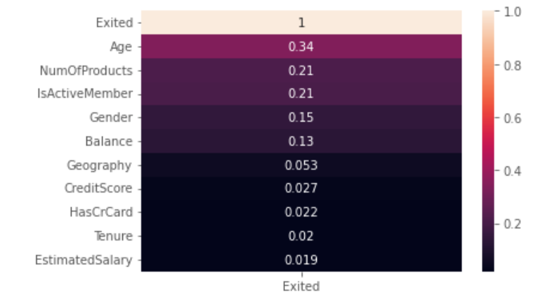
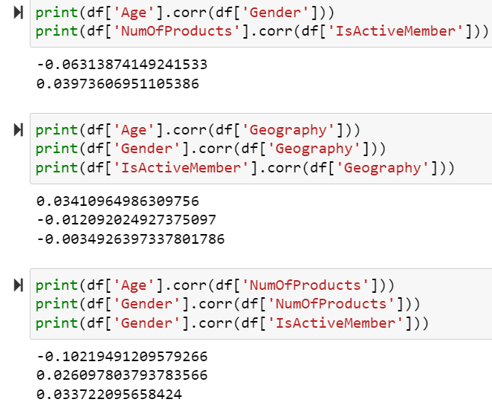
Model development(cont’d)
2. Multicollinearity checks have been performed on the predictor variables and variables with high correlation with other x variables have been removed.

Slide 10
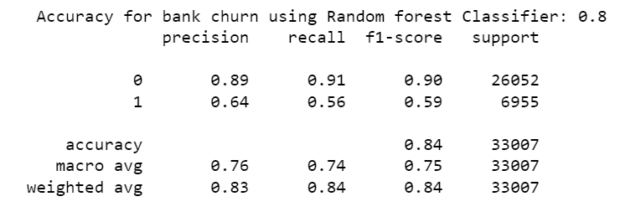
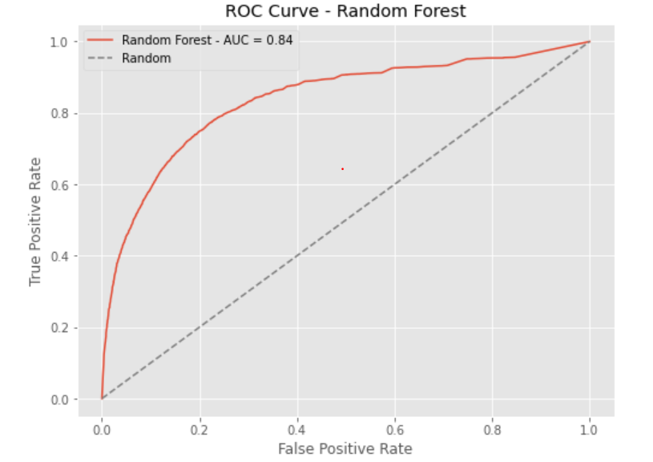
Model development(cont’d)
3. Random forest model to predict the customer churn using Age, Numofproducts, IsActiveMember, Gender, Balance, and Geography as predictor variables gives an accuracy of 0.84 with an AUC-ROC value of 0.84.

Slide 11
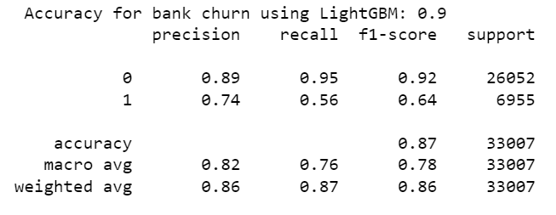
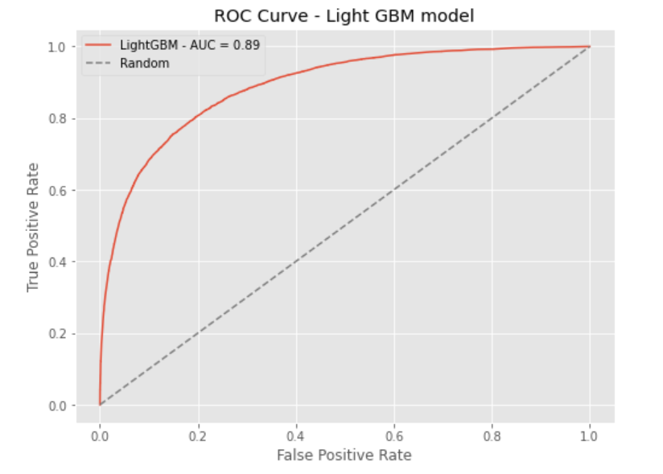
Model development(cont’d)
3. The LightGBM model to predict customer churn using Age, Numofproducts, IsActiveMember, Gender, Balance, and Geography as predictor variables gives an accuracy of 0.87 with an AUC-ROC value of 0.89.
Hence the LightGBM performs better than Random Forest for the given dataset and feature importance will be evaluated using the LightGBM model.

Slide 12
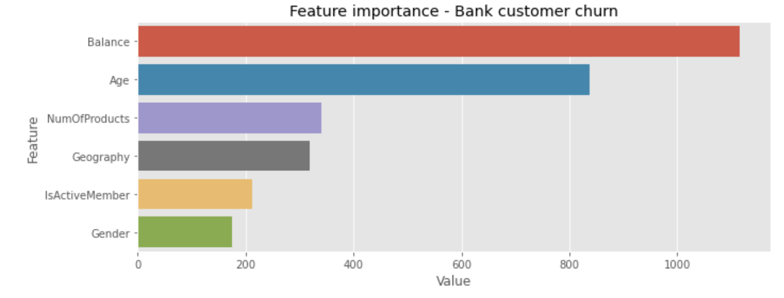
Results
The following recommendations could be made to the bank based on the model results.
The amount of money the customer holds in the bank and the age plays a main role in assessing whether the customer will stay longer or not.
The prediction results will vary with different locations of the bank as ‘geography’ contributes to customer behaviour.
It is important for the bank to attract customers by offering various products that can keep them active and hence stay longer with them.

Slide 13
THANK YOU
Deborah Paul
deboj777@gmail.com

